Slide 1
Superstore Sales Analysis Dashboard
Created in Power BI using the Sample Superstore Dataset

Slide 2
Objective of the Dashboard
To design an interactive and insightful dashboard that helps stakeholders understand:
Overall sales and profit trends
Regional performance
Category and sub-category performance
Product-level contribution
Geographical sales distribution

Slide 3
Key Metrics and Visuals Used
🔹 KPIs (Cards):
- Total Sales
- Total Profit
- Total Quantity Sold
- Distinct Order Count
🔹 Charts & Visuals:
- Line Chart: Sales & Profit over Time
- Bar Chart: Sales/Profit/Quantity by Category
- Table: Product-wise Sales & Profit
- Stacked Bar: Profit by Region and Category
- Map: State-wise Sales
- Tree Map: Sub-category-wise Sales & Profit
- Slicers for dynamic filtering (Region, Category, Segment, Date)

Slide 4
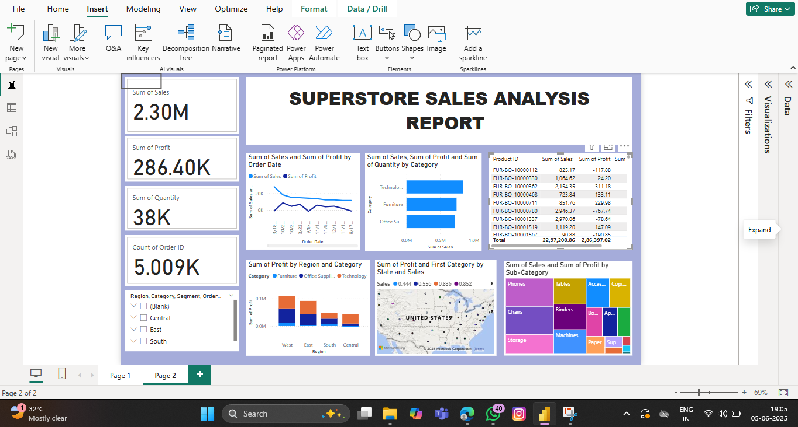

Slide 5
Key Insights & Conclusion
- Technology category generates the highest sales, but profit varies by region.
- Some sub-categories like Machines and Binders are high-performing.
- Central and West regions show strong sales and profitability.
- State-level analysis reveals performance variation helpful for targeted strategies.
📌 This dashboard helps stakeholders identify focus areas, track KPIs, and support data-driven decisions.

